Slide 1
CSSE 332 pthread

Slide 2
Agenda
Intro: Concurrent programing
Parallel computing with pthread.
(+) Performance improvement
(-) Concurrency issues – mutual exclusion

Slide 3
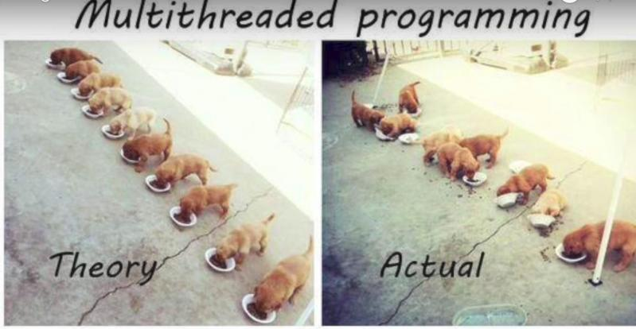
Concurrent Programming
Run multiple “things” (processes, threads) simultaneously
Share resources!!

Slide 4
Intro to pthreads
May be provided either as user-level or kernel-level
A POSIX standard (IEEE 1003.1c) API for thread creation and synchronization
API specifies behavior of the thread library, implementation is up to development of the library
Common in UNIX operating systems (Solaris, Linux, Mac OS X; in the kernel)

Slide 5
Similar effort: Java threads
Java threads are managed by the JVM
Typically implemented using the threads model provided by underlying OS
Java threads may be created by:
Extending Thread class
Implementing the Runnable interface

Slide 6
PThreads: Compiling
To compile a program that uses POSIX Threads, we need to include the pthreads header in our source code:
#include <pthreads.h>
And pass the -pthread flag to the compiler:
$ gcc -o program program.c -pthread
Adapted from Peter Bui@ND

Slide 7
PThreads: Creating
When our program starts, we have one main thread. To create another one, we can use the pthread_create function:
void *function(void *arg) { // Thread function
int tid = *((int*) arg);
printf("thread %d\n", tid);
return NULL;
}
pthread_t thread; // Thread structure
int i = 7;
pthread_create(&thread, NULL, function, &i); // Create thread
What if function needs more input arguments?
Adapted from Peter Bui@ND

Slide 8

PThreads: Waiting
To wait for a thread to complete, we can use the pthread_join function:
int* result;
pthread_join(thread, (void **)&result);
A thread can return a value either by doing return or pthread_exit:
pthread_exit(NULL);
Adapted from Peter Bui@ND

Slide 9
Let's use pthreads
Look at the threadSpeedTest code, play just a bit with adjusting the size
Then modify it so it makes more threads according to the THREAD_COUNT variable. BTW if you finish early you can also make the fork section respect that variable.

Slide 10
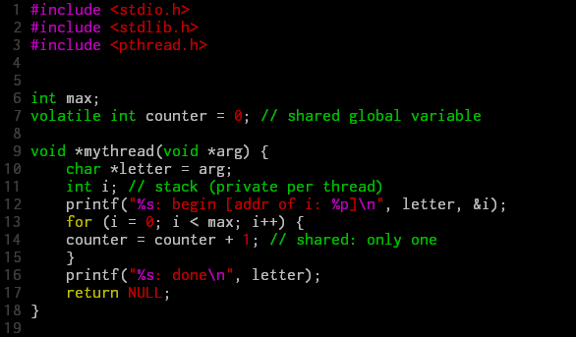
Problems with concurrent programming
* volatile means the variable may change.

Slide 11
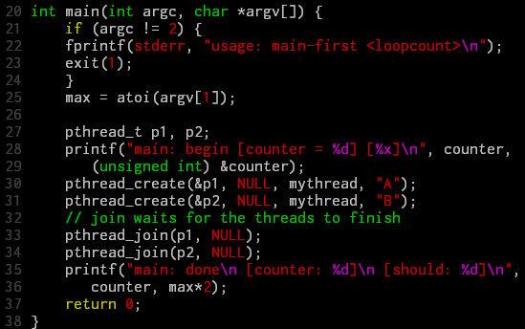
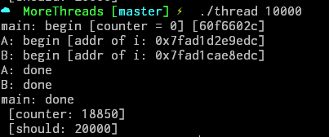


Problems with concurrent programming (cont.)

Slide 12
Problem investigation
mov 0x8049a1c, %eax //1. load count
add $0x1, %eax //2. add one
mov %eax, 0x8049a1c //3. store new value
count = count + 1 →
If ..
Thread 1
Thread 2
mov 0x8049a1c, %eax
add $0x1, %eax
mov %eax, 0x8049a1c
mov 0x8049a1c, %eax
add $0x1, %eax
mov %eax, 0x8049a1c

Slide 13
Solution: The Wish For Atomicity
Goal: finish code in a critical section as a unit – no interrupt.
Correctness
Performance

Slide 14


Approach #1
Disable/enable alarm
1 void lock() {
2 DisableInterrupts();
3 }
4 void unlock() {
5 EnableInterrupts();
6 }
But dangerous that any program may monopolize the CPU.
Correct
Performance

Slide 15

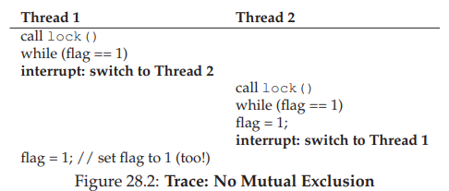
Approach #2
Correct
Performance
Use a global flag
1 typedef struct __lock_t { int flag; } lock_t;
2
3 void init(lock_t *mutex) {
4 // 0 -> lock is available, 1 -> held
5 mutex->flag = 0;
6 }
7
8 void lock(lock_t *mutex) {
9 while (mutex->flag == 1) // TEST the flag
10 ; // spin-wait (do nothing)
11 mutex->flag = 1; // now SET it!
12 }
13
14 void unlock(lock_t *mutex) {
15 mutex->flag = 0;
16 }

Slide 16
Solution: Mutual exclusion
We'll talk about actual working solutions in future classes

Slide 17
Approach #3
Use atomic function which is supported by hardware
1 int TestAndSet(int *old_ptr, int new) {
2 int old = *old_ptr; // fetch old value at old_ptr
3 *old_ptr = new; // store ’new’ into old_ptr
4 return old; // return the old value
5 }
Get the old value and set the new value.

Slide 18
Approach #3 (cont.)
Correct
Performance
1 typedef struct __lock_t {
2 int flag;
3 } lock_t;
4
5 void init(lock_t *lock) {
6 // 0 indicates that lock is available, 1 that it is held
7 lock->flag = 0;
8 }
9
10 void lock(lock_t *lock) {
11 while (TestAndSet(&lock->flag, 1) == 1)
12 ; // spin-wait (do nothing)
13 }
14
15 void unlock(lock_t *lock) {
16 lock->flag = 0;
17 }

Slide 19
Approach #4
Atomic with park()

